Slide 1


Control car with hand motion
By :
Kareem Magdy Mohamed Hemdan

Slide 2
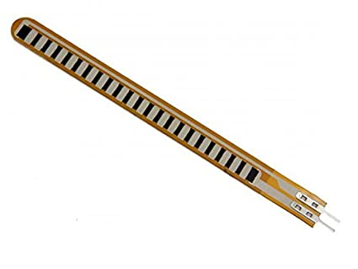
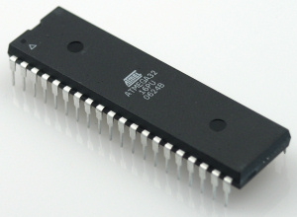
Components
Flex sensor : It converts finger gestures into analogue voltages, which are fed to the microcontroller.
ATmega32 microcontroller 1. Takes flex sensor input from the internal analogue-to-digital controller (ADC) and checks whether it exceeds certain threshold limit when the sensor is bent 2. Rotates right and left motors in forward or reverse direction to move the car in the desired direction 3. Displays car movement on the LCD
LCD : It displays messages about the car’s movement direction as well as other messages

Slide 3
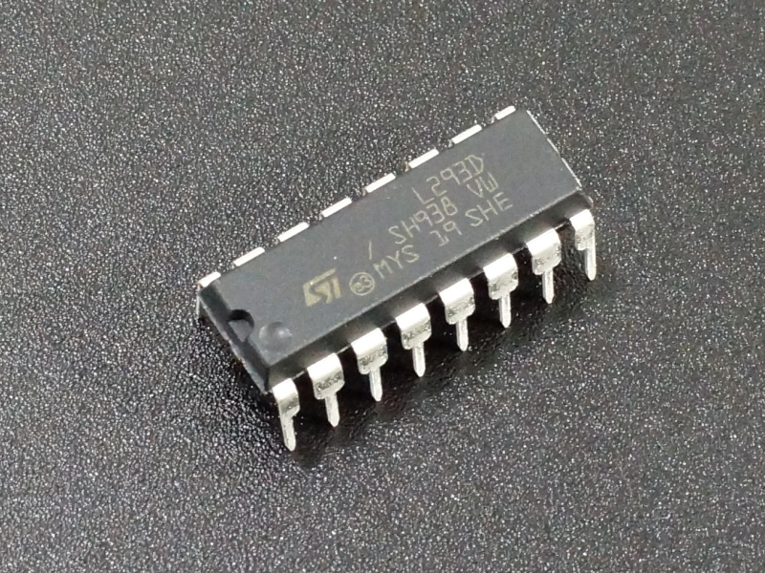
Components
L293D driver : It provides sufficient voltage and current for DC motors to drive the car
DC motors : The four DC motors move the car in 2 directions: forward & reverse.

Slide 4
Target :
control motors directions and speed by flex sensors

Slide 5
Steps :
1-) First we connect two Atmega32 to each other by using SPI
2-) then, we connect the flex sensors to the master microcontroller in pins (PA4,PA5,PA6)
3-) we programmed the master to check if the flex sensors start to work : if the first flex sensor works then we send number (1) to slave if the second flex sensor works then we send number (2) to slave if the third flex sensor works then we send number (3) to slave
if the fourth flex sensor works then the ADC will convert the analogue signal of it to digital and send it slave

Slide 6
Steps :
4-) we programmed the slave to control the motors in 2 directions by L293D
5-) we connect the motors to L293D
6-) we connect the L293D to the microcontroller (slave) in pins (PC3,PC4,PC5,PC6) and the enables to OCR0
7-) we programmed the slave to interface with LCD with 4-bit mode
8-) we connect the LCD to the slave

Slide 7
Steps :
9-) then we programmed the slave : if it received 1 then it will move the Motors forward and write FORWARD in LCD if it received 2 then it will stop the motor and write STOP in LCD if it received 3 then it will move the motors back and write BACK in LCD
If it received more than 3 then it will move the motors forward with speed depend on the read of OCR0

Slide 8
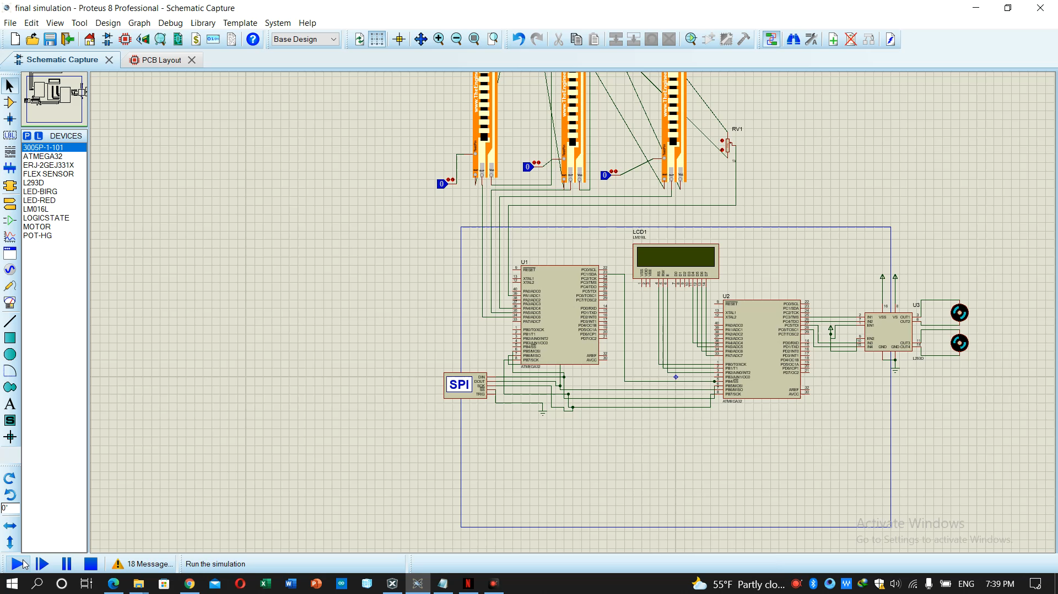
The final result

